Slide 1
SIT374/764: Project Management
Lecture 6: cost management

Slide 2
Project management process groups
Approved Project Management Plan
Completion Report
Monitoring
Initiation
Planning
Executing
Closing
Control
Approved Project Charter
Customer signoff

Slide 3
Project management process groups - Activity Map
Monitor &
Control Proj.
Project Plan
Acquire & manage
team
Project
Closing
Project Charter
Scope
Time
Cost
Quality
HR
Risk
Procurement
Stakeholders
Comm.
Scope control &
verification
Stakeholders
Register
Select Sellers &
POs
Schedule control
Contract
Closing
Cost control
Progress Reporting
Perform QA
Manage Stakeholders
Comm.
Contract Admin
Initiation
Planning
Executing
Mon. & Con.
Closing

Slide 4
COST MANAGEMENT
IT projects have a poor record of meeting budget goals.
There is a scope for improvement in IT projects to meet the cost goals
We need to discuss
Concepts of project cost management
Estimating costs
Determining the Budget
Earned value management to control the costs

Slide 5
COST MANAGEMENT
Cost overruns are caused by:
original cost estimates being too low
original cost estimates based on unclear project requirements
many project managers think preparing cost estimates is a job for accountants
untested technology
untested business processes

Slide 6
Cost vs. Revenue vs. Profit
Cost is resources expended to achieve a goal
Usually measured in monetary units
Cost management is the process to ensure project is completed within budget
Revenue is the income from the normal business activities
Profit (net benefit) = Revenue (benefit) – Cost (expenditure) (To increase profit : Reduce cost or Increase revenue)

Slide 7
NPV analysis
NPV = discounted (benefit) – discounted (cost)
If… | It indicates… | Then…
NPV > 0 | the investment would add value to the firm | the project may be accepted
NPV < 0 | the investment would subtract value from the firm | the project should be rejected
NPV = 0 | the investment would neither gain nor lose value for the firm | indifferent in the decision This project adds no monetary value. Decision should be based on other criteria, e.g., strategic positioning or other factors not explicitly included in the calculation.

Slide 8
Types of Costs
Fixed vs. variable cost:
Fixed costs stay the costs that remain the same and do not change throughout the project life cycle . Examples of fixed costs include setup costs, rental costs etc.
Variable costs are costs that change with the amount of work. Examples of variable costs are hourly labor, cost of material, cost of supply, fuel etc.
Tangible vs. Intangible cost
Tangible costs or benefits are those costs or benefits that an organization can easily measure in dollars
A task that was allocated $150,000 but actually costs $100,000 would have a tangible benefit of $50,000 if the assets allocated are used for other projects
Intangible costs or benefits are costs or benefits that are difficult to measure in monetary terms
Costs – resources used to research related areas of a project but not billed to the project
Benefits – goodwill, prestige, general statements of improved productivity not easily translated in dollars

Slide 9
TYPEs of Costs
Direct costs are costs that can be directly related to producing the products and services of the project
Salaries, cost of hardware and software purchased specifically for the project
Indirect costs are costs that are not directly related to the products or services of the project, but are indirectly related to performing the project
Cost of electricity, paper towels
Sunk cost is money that has been spent in the past; when deciding what projects to invest in or continue, you should not include sunk costs
To continue funding a failed project because a great deal of money has already been spent on it is not a valid way to decide on which projects to fund
Sunk costs should be forgotten

Slide 10
TYPEs of Costs
Reserves are dollars included in a cost estimate to mitigate cost risk by allowing for future situations that are difficult to predict
Contingency reserves allow for future situations that may be partially planned for (sometimes called known unknowns) and are included in the project cost baseline
Recruiting and training costs for expected personnel turnover during a project
Management reserves allow for future situations that are unpredictable (sometimes called unknown unknowns)
Extended absence of a manager; supplier goes out of business

Slide 11
Activity 1
Based on the information provided in Cost management-Activity 1, identify the types of costs associated with this IT project. Categorize each cost.

Slide 12
Processes in Cost Management
Determine Project Budget
Control Cost
Estimate Activity Cost
Plan Cost Management
Planning
Monitoring and
Controlling

Slide 13
1. Plan cost management
Plan cost management is the process of defining how the costs will be estimated, budgeted, monitored, and controlled.
Key inputs include the project charter, schedule management plan, and organizational process assets.
The main output is the schedule management plan.
Sample Cost Management Plan

Slide 14
cost management plan
Cost management plan is a component of project management plan and describes how the cost will be planned, structured, and controlled. Can establish the following:
Tools/techniques used
Units of measure
Level of precision
Control thresholds
Rules of performance measurement
Earned value management (EVM)
Reporting format

Slide 15
2. estimate costs
Estimate Costs is the process of developing an approximation or estimate of the costs of the resources needed to complete a project.
Key benefit is that it determines the monetary resources required for the project.
Cost estimates

Slide 16
TYPES OF ESTIMATES
Rough order magnitude (ROM) : Ballpark estimate. Done very early in the project (even before the project starts). Accuracy : -50 to +100% (actual cost could be 50% below or 100% above this estimate)
A Budgetary Estimate: Made 1-2 years prior to the project completion. Used to allocate money to the organization’s budget. Accuracy : -10% to +25%
Definitive Estimate: Provides accurate estimates of the project cost and is used to make purchasing decisions.

Slide 17
Estimation techniques
Analogous Estimate: similar project is the basis for estimating the cost. Less costly, but less accurate.
Bottom-Up Estimate: involves estimating individual work items or activities to get the project total cost. Also called activity-based costing.
Accuracy of the estimate depends upon: size of the individual work item and experience of the estimator.
Parametric modelling: uses project characteristics (parameters) in a mathematical model to estimate project cost. Reliable when historical information is available.
Software application -COCOMOII model (uses size of the software) and characteristics of software.

Slide 18
Activity 2
Based on the information provided in Cost management-Activity 2, calculate the estimated software development cost for the project.

Slide 19
WBS and activity-level estimate
Cost estimation at WBS level
Used in early stages when detailed task-level information may not be fully developed.
Useful for initial budgeting and securing funding.
Cost estimation in activity level
Used once the activities are detailed out.
Provides more detailed and accurate cost estimate.

Slide 20
Cost estimate
For various WBS items/activities we need cost per unit and total number in units.
Contingency reserves are calculated : Usually, 20% of total project cost estimate
Useful to estimate the total cost for each category (especially for higher management)

Slide 21
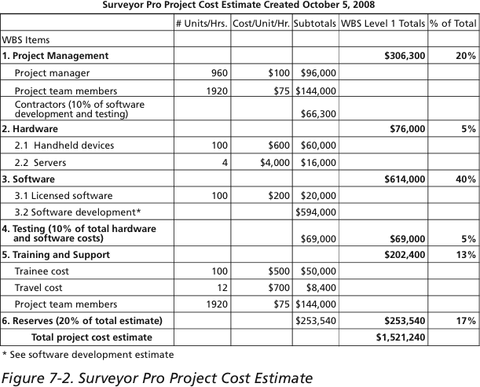
SAMPLE Cost Estimate
Notes:
Surveyor Pro Project : Cost estimate for Internet Site project (Kathy Schwalbe)
Contingency Reserves : 1,267,700 * (20/100)

Slide 22
3. Determine budget
Determine Budget is the process of aggregating the estimated costs to create project budget and an authorized cost baseline.
Key benefit is that it determines the cost baseline which project performance can be monitored and controlled.
Project budget, cost baseline, funding requirements
Notes:
The ultimate
goal of developing the schedule is to create a realistic project schedule that provides
a basis for monitoring project progress for the time dimension of the project.
The schedule development is the final deliverable of time management in terms of planning. All the previous docs like activity, dependency, resource are acting as the input for making the schedule.

Slide 23
Budget and Cost Baseline
Cost baseline: approved version of time-framed project budget, excluding management reserves.
Cost estimates make up the cost baseline
Since cost baseline is tied to schedule activities, it has a time-phased view.
Budget: produced by adding management reserves to cost baseline
Change control process can be used to move management reserve into cost baseline

Slide 24
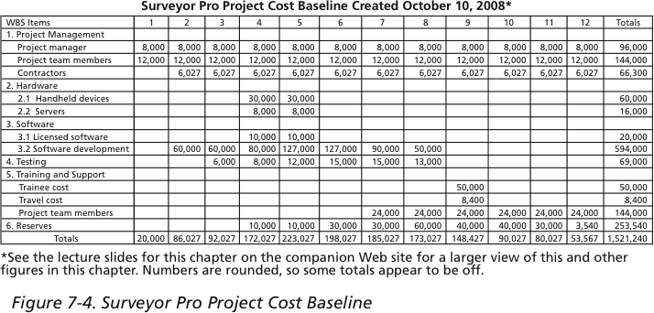
Sample Cost Baseline
*Numbers are rounded, so some totals appear to be off.

Slide 25
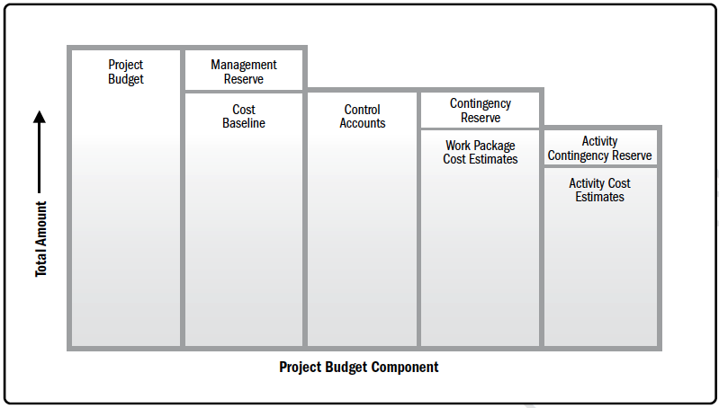
Budget component

Slide 26
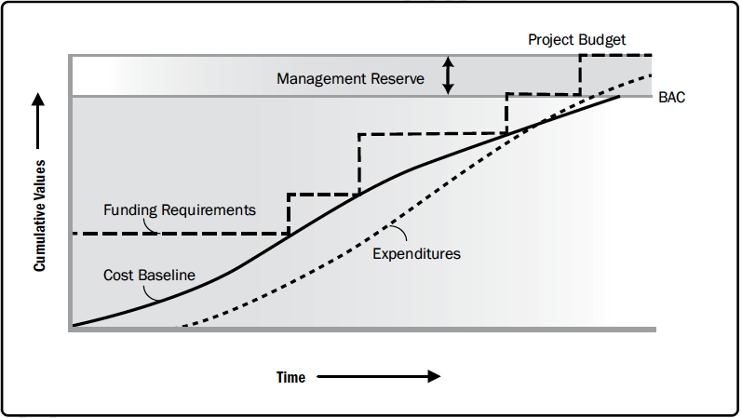
Funding requirements
Derived from cost baseline
Total funds are those
included in cost baseline
plus management reserves
Often occurs in
incremental amounts

Slide 27
4. Cost Control
Monitoring expenditure
Gain insights into performance information
Controlling changes to the project budget

Slide 28
Earned Value Management (EVM)
EVM: Project performance management technique involves all the three project constraints (scope, time, cost).
Integrates scope baseline with cost baseline, and schedule baseline to form performance measurement baseline.
Given a project baseline, EVM allows to measure how well project meets goals. (By entering actual information and then comparing it to the baseline)

Slide 29
Three key dimensions to be monitored
Planned Value (PV) or Budgeted Cost of Work Scheduled (BCWS): portion of total cost estimate planned to be spent on an activity in a given period.
Actual Cost (AC) or Actual Cost of Work Performed (ACWP): is direct and indirect cost incurred on an activity during a given period.
Earned Value (EV) or Budgeted Cost of Work Performed (BCWP): is estimate of physical work actually completed.
(EV is based on the original planned costs for the project or activity and the rate at which the team is completing work on the project or activity to date)
Notes:
Rate of Performance (RP) : E.g. : server installation was completed halfway by the end of Week 1. The rate of performance would be 50% (50/100), bacasue by the end of the week only 50% of the work could be completed.

Slide 30
Variance analysis
Determine the degree of variance between the baseline and the actual project performance.
Schedule variance (SV): the amount the project is ahead or behind the planned delivery date. SV=EV-PV
Cost variance (CV): the amount of project deficit or surplus at a given point. CV=EV-AC
Schedule performance index (SPI): schedule efficiency. SPI=EV/PV
Cost performance index (CPI): cost efficiency. CPI=EV/AC

Slide 31
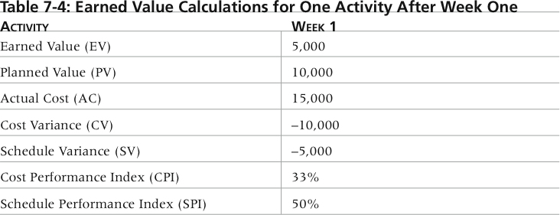
Variance Calculations for One Activity After Week One

Slide 32
Variance insights
Negative numbers for cost and schedule variance indicate problems in those areas
A CPI or SPI that is less than 100% indicates problems means the project is
costing more than planned (over budget)
taking longer than planned (behind schedule)

Slide 33
Trend analysis
Determine the performance over time to determine if the performance is improving or not.
Forecast future performance.
Budget at completion (BAC): the original total budget for the project.
Estimate at completion (EAC): a forecast/estimate of what it will cost to complete the project

Slide 34

Estimate at completion (EAC)
A few methods could be used to compute EAC. 2 most commonly used are:
EAC based on the budgeted rate: accepts the actual costs, and predict all future work will be accomplished at the budgeted rate. EAC=AC+BAC-EV
EAC based on the present CPI: assumes that what the project experienced to date can continue in the future. EAC=BAC/CPI
EAC based on both CPI and SPI: effective when schedule is an impacting factor. EAC=AC+(BAC-EV)/(CPI$×$SPI)

Slide 35
Estimated time to completion
Estimated time to completion is based on actual elapsed time and forecasted remaining time.
Original Project Duration (OPD): initially planned duration of the project
Elapsed Time (ET): time that has already been spent
Estimated Time to Completion (ETC): ETC=ET+(OPD-ET)/SPI
Other methods to compute ETC? How to select?

Slide 36
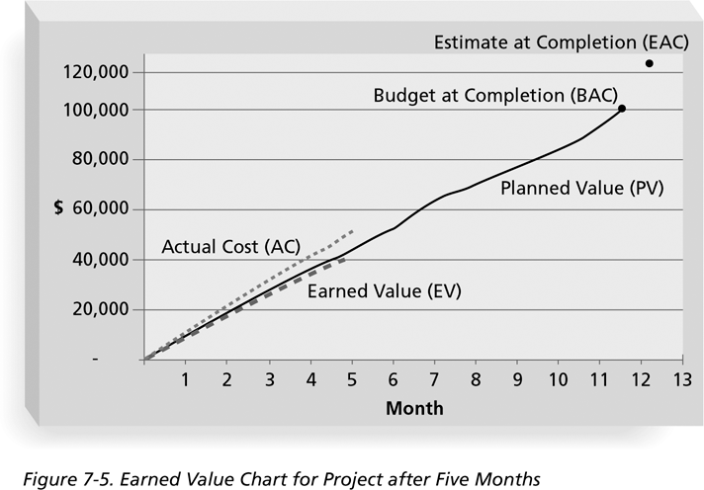
Earned Value Chart

Slide 37
Earned Value Chart
The chart helps visualize how the project is performing.
If the project goes as planned, it will finish in 12 months at a cost of $100,000
The actual cost line is always right on or above the earned value line.
Interpretation: This means costs are equal to or more than planned
The planned value line is pretty close to the EV line, just slightly higher in the last month
Interpretation: The project has been right on schedule until last month when the project fell behind schedule

Slide 38
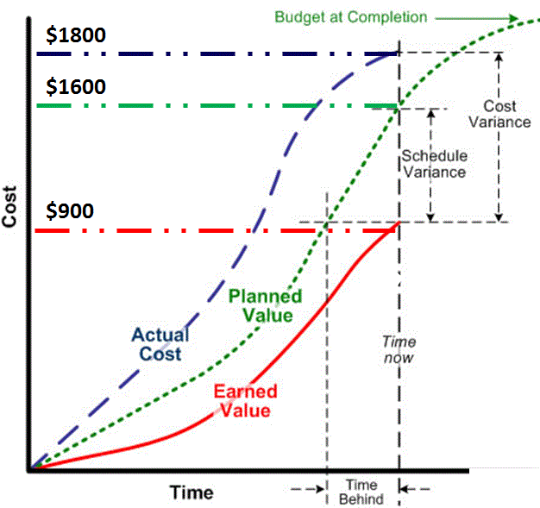
EVM Example

Slide 39
Activity 3
Based on the information provided in Cost management-Activity 3,
Calculate the Cost Variance (CV) and Schedule Variance (SV) at the end of the sixth month.
Determine the Cost Performance Index (CPI) and Schedule Performance Index (SPI) at this point in the project.
Given the discovered underestimation, calculate the Estimate at Completion (EAC) assuming the current cost performance will continue for the remainder of the project.
Compute the Estimated Completion Time (ECT), assuming the current rate of progress continues, and compare it with the original schedule.
Discuss the implications of these findings and recommend strategies for the project manager to address the project's current status.

Slide 40
Summary
Cost management
Plan
Estimate cost
Determine budget
Cost control
EVM, variance analysis, trend analysis
SV, CV, CPI, SPI, EAC, BAC, ETC

Slide 41
What’s next
Next area of project management – risk management

